Slide 1
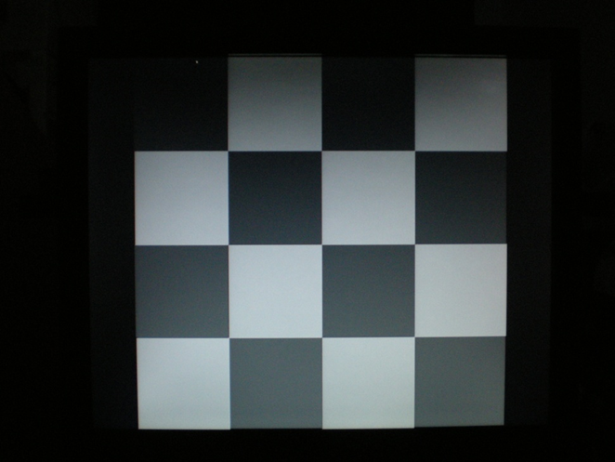
Objective measure of binocularity using VEP in TBI patients undergoing vision therapy
Dr. Mohamed Moussa, M.B.B.Ch, M.Sc.1, O.D., FAAO Dr. Abeer Ahmed, M.B.B.Ch, M.Sc.2
Dr. Ali Raza,, MBBCh.3 Dr Mohamed Higazy M.B.B.Ch. M.Sc.,MD, 4
1,2,3,4: Pediatric Vision Therapy & Research Center, Windsor, ON, Canada.
Abstract
Procedure
Results
Case Description
Discussion
Background and Aims: The study was conducted to determine whether visual cortex activity in patients diagnosed with Post Trauma Vision Syndrome (PTVS), particularly eye-to-brain signal strength and delay, can be improved through vision therapy. Brain injuries in PTVS patients affect the propagation of electrical signals from the optic nerves to the visual cortex, which can disrupt normal binocular vision. Normally, the brain combines both eye signals, recorded by a Visual Evoked Potential (VEP) instrument, in ‘summation’, producing a higher amplitude than each eye individually. However, PTVS can cause ‘suppression’ or ‘interference’, where the combined signal is actually equal or lower than the signal coming from strongest eye signal. PTVS can also introduce delays in eye-to-brain signals.
Methods: The study measured patterns of VEP signals when presented with five sizes of targets, 100% contrast, and taking monocular and binocular measures. Eight patients were going through vision therapy and ten did not do VT. Retest measures were done for twenty and forty week intervals. The presence of interference in binocular measurement with no delays assumed to serve as objective indicators for BV (binocular vision) dysfunction. Any interference was considered to be at some level of BV dysfunction, causing levels to be 20% to 80% in both groups initially. Results: In terms of signal summation amplitude, a comparison between the therapy and control results after 40 weeks showed improved summation in 90% of Therapy subjects (P=0.00941vs) and no significant improvement in Control subjects (P=0.78). Of the subjects in the Therapy Group that experienced signal delay, 64% showed improvement in this delay (P=0.014). This compared favourably to the Control Group P, which showed improvement in only 10% of subjects that experienced delay.
The study was done using Diopsys VEP with 100% contrast level. The study measured patterns of VEP signal when presented with five sizes of targets, 100% contrast, and taking monocular and binocular measures. Eight patients who completed at least two measures were going through vision therapy and ten did not do VT (control group). The control group was not able to do VT due to insurance related and financial reasons. Retest measures were done for twenty and forty week intervals. The presence of interference in binocular measurement with no delays assumed to serve as an objective indicator for BV (binocular vision) dysfunction. Any interference was considered to be at some level of BV dysfunction, causing levels to be 20% to 80% in both groups initially. The measured VEP values of monocular measures were compared to binocular measures. These were considered normal if interference were found to be a value of 0, suppression a value of 10 (equal binocular to monocular), and binocular summation a value of 20. All subjects had TBI at least 6 months prior to testing and still had visual symptoms at the time of the study.
The study also analysed the signal conduction of both groups.
Results: In terms of signal summation amplitude, a comparison between the therapy and control results after 40 weeks showed improved summation in 90% of therapy subjects after therapy (P=0.00941vs) Fig2 and no significant improvement in Control subjects (P=0.78) Fig3. The improvement in summation reflects that increased binocularity exists for different sizes of targets.
Of the subjects in the Therapy group that experienced signal delay, 64% showed improvement in this delay (P=0.014). This compared favourably to the Control group, which saw no significant improvement in signal delay.
In combat situations, retrospective studies have found that 74% of soldiers with PTSD have visual symptoms. This explains why many cases of significant TBI can lead to disturbances in visual functions. Convergence insufficiency was found in almost 40% of recent cases of soldiers with TBI. After 2-3 years, convergence insufficiency 42% in TBI patients and 39% in cerebrovascular accident patients. Motor dysfunction is found to be almost in 90% in TBI cases and 87% in CVA cases. The interference in signal between both eyes is found in cases of binocular dysfunction.
In a study involving 40 patients, the results of VT rehab showed improved visual symptoms in 90% of TBI patients and 100% of CVA patients. Improvement in the VEP binocular signal has been shown in previous studies to prove that bi-nasal patching and prisms can improve the binocular vision function in these conditions. This study shows that VT can help TBI patients improve their binocularity which can be measured objectively and provide a new formula to measure these results. The use of VEP can help the objective measurement of PTVS and can help follow the progress of therapy. The cost of VEP is very reasonable compared to other measures of brain dysfunction such as SPECT scans or fMRI that provide similar functional measures. The use of VEP shows that VT improves signal conduction if there is an initial delay and provides evidence on the effect of VT in these conditions.
Figure 2. Binocular amplitude graph before and after therapy
Figure 1. Target presented
Introduction
Conclusion
The study was conducted to determine whether visual cortex activity in patients diagnosed with Post Trauma Vision Syndrome (PTVS), particularly eye-to-brain signal strength and delay, can be improved through vision therapy. Brain injuries in PTVS patients affect the propagation of electrical signals from the optic nerve to the visual cortex, which can disrupt normal binocular vision. Normally, the brain combines both eye signals, recorded by a Visual Evoked Potential (VEP) instrument, in ‘summation’, producing a higher amplitude than each eye individually. However, PTVS or BV dysfunction can cause ‘suppression’ or ‘interference’, where the combined signal is actually equal or lower than the signal coming from strongest eye signal. PTVS can also introduce delays in eye-to-brain signals.
The study was conducted to measure the effect of vision therapy and whether VEP can be used to measure the improved binocularity with treatment in this population. The study also measures whether signal function can be improved without vision therapy.
Figure 3. Binocularity graph for No therapy control
Conclusion: VEP can be used as an objective measure for PTVS BV dysfunction. VEP can also be used to measure progression of BV dysfunction improvement in TBI. VT is a necessary treatment for the recovery of TBI patients with visual symptoms especially if symptoms is persistent after injury.
Table 1. Patient MW
Level | Initial visit |  | Follow up visit
8X8 | Interference | 0 | suppression | 10
16X16 | Interference | 0 | summation | 20
32X32 | suppression | 10 | summation | 20
64X64 | summation | 20 | summation | 20
128X128 | interference | 0 | interference | 0
Total |  | 30 |  | 70
References
Cohen,M.,Grosswasser,Z.,Brachadski, R.,&Appel,A.(1989). Convergence insufficiency in brain injured patients. Brain Injury, 3(2), 187-191.
Yadav NK, Ciuffreda KJ. Effect of binasal occlusion (BNO) and base-in prisms on the visual-evoked potential (VEP) in mild traumatic brain injury (mTBI).Brain Inj. 2014;28(12):1568-80.
Padula WV, Nelson CA, Padula WV, Benabib R, Yilmaz T, Krevisky S.Modifying postural adaptation following a CVA through prismatic shift of visuo-spatial egocenter. Brain Injury. 2009;23(6):566-576.
Padula W, Argyris S, Ray J. Visual Evoked Vision syndrome (PTVS) in patients with traumatic brain injuries (TBI), Brain Injury, 1994;8(2):125-133
For further question regarding this case you can contact Dr Mohamed Moussa moussaeyedoctor@gmail.com

